Slide 1













EventFlow Event Management System
Streamlining Event Management Excellence
Event Creation
Ticketing
Attendee Management
Analytics
Developed by: EventFlow Team
Bassey Esin Elliot, Wangchen Peng, and Souravdeep Durgesh Singh

Slide 2



















The Problem & Our Solution
The Problem
Our Solution: EventFlow
Inefficient Ticketing
Streamlined Event Lifecycle
Manual processes leading to delays and errors
Integrated platform managing end-to-end event processes
Fragmented Communication
Seamless Ticketing
Disparate channels for announcements and updates
Automated registration and payment processing
Poor Attendee Engagement
Unified Communication
Limited interaction opportunities and networking
Centralized platform for all event announcements
Lost Revenue
Enhanced Engagement
Underutilized capacity and manual follow-ups
Features empowering organizers and enhancing attendee experience
EventFlow: Transforming event management through integration

Slide 3


























Core Features Overview
User Authentication
Event Creation
Ticketing & Registration
Secure login with role-based access control for organizers, attendees, and administrators
Intuitive tools for creating, editing, and publishing events with scheduling and venue details
Flexible ticketing options with customizable registration forms and attendee data management
Payment Integration
Notification System
Attendee Networking
Secure integration with major payment gateways for smooth transaction processing
Automated email and in-app notifications for registration confirmations and event updates
Features to facilitate interaction among attendees, such as chat functions and profile visibility
Analytics & Reporting
Marketing & Promotion
Post-Event Feedback
Comprehensive dashboards and reports on registration numbers, ticket sales, and event performance
Tools for event promotion, including social media integration and customizable landing pages
Mechanisms for collecting attendee feedback to improve future events

Slide 4













Key Business Objectives
Measurable targets for EventFlow success
Registration Processing
System Capacity
Revenue Growth
75%
10,000
15%
Reduction in Processing Time
Concurrent Users
Increase in Revenue Per Event
Automating workflow to cut down manual processing
Support for large-scale events without performance issues
Optimizing ticketing and engagement strategies
These objectives drive EventFlow's strategic development

Slide 5
























Technical Architecture
Microservices architecture for scalability and resilience
Frontend
Backend Services
User-facing interface for organizers and attendees
Independent services for specific functionalities
API Gateway
Single entry point for all client requests
Databases
Dedicated databases for each microservice
Dynamic service registration and discovery
Scalability
Fault Tolerance
Technology Flexibility
Independent scaling of services based on demand
Isolated service failures don't impact the entire system
Different technologies for different service needs

Slide 6




















Technology Stack
The technologies powering EventFlow
Frontend Technologies
Backend Technologies
React
Java
Declarative, component-based JavaScript library
Platform-independent programming language
Redux
Spring Boot
State container for JavaScript apps
Framework for production-ready Spring apps
Material-UI
Spring Cloud
React UI framework implementing Material Design
Tools for building patterns in distributed systems
MySQL & MongoDB
Relational and NoSQL databases for data storage

Slide 7
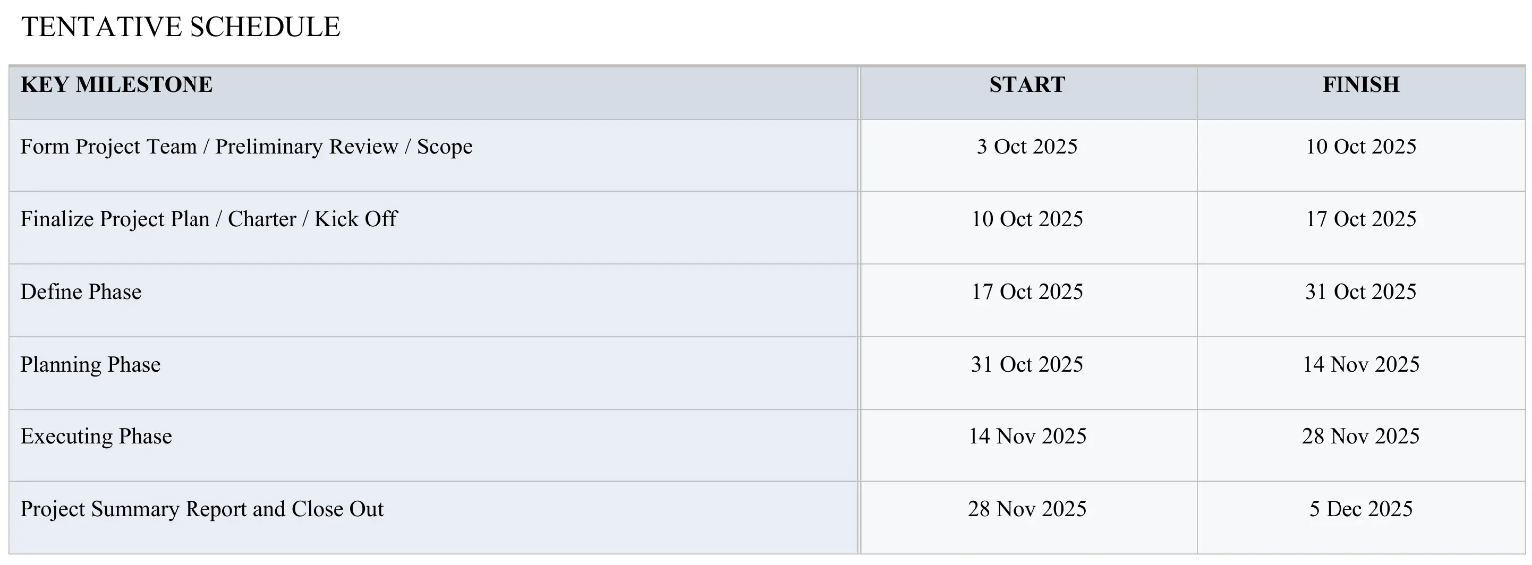

























Project Timeline & Critical Path
The EventFlow project followed a structured timeline with key milestones to ensure efficient progress and timely delivery.
Critical Path Analysis
Team Formation
System Design
Payment Integration
Core Development
User Testing
Security Review
Deployment
Establishing core team and defining project scope
Architecture and database design foundation
Secure payment processing capabilities
Building central EventFlow functionalities
Validating system against user requirements
Ensuring compliance with security standards
Launching EventFlow for public use
Key Insight: Critical path tasks were prioritized and closely managed to prevent delays and ensure timely project completion.

Slide 8





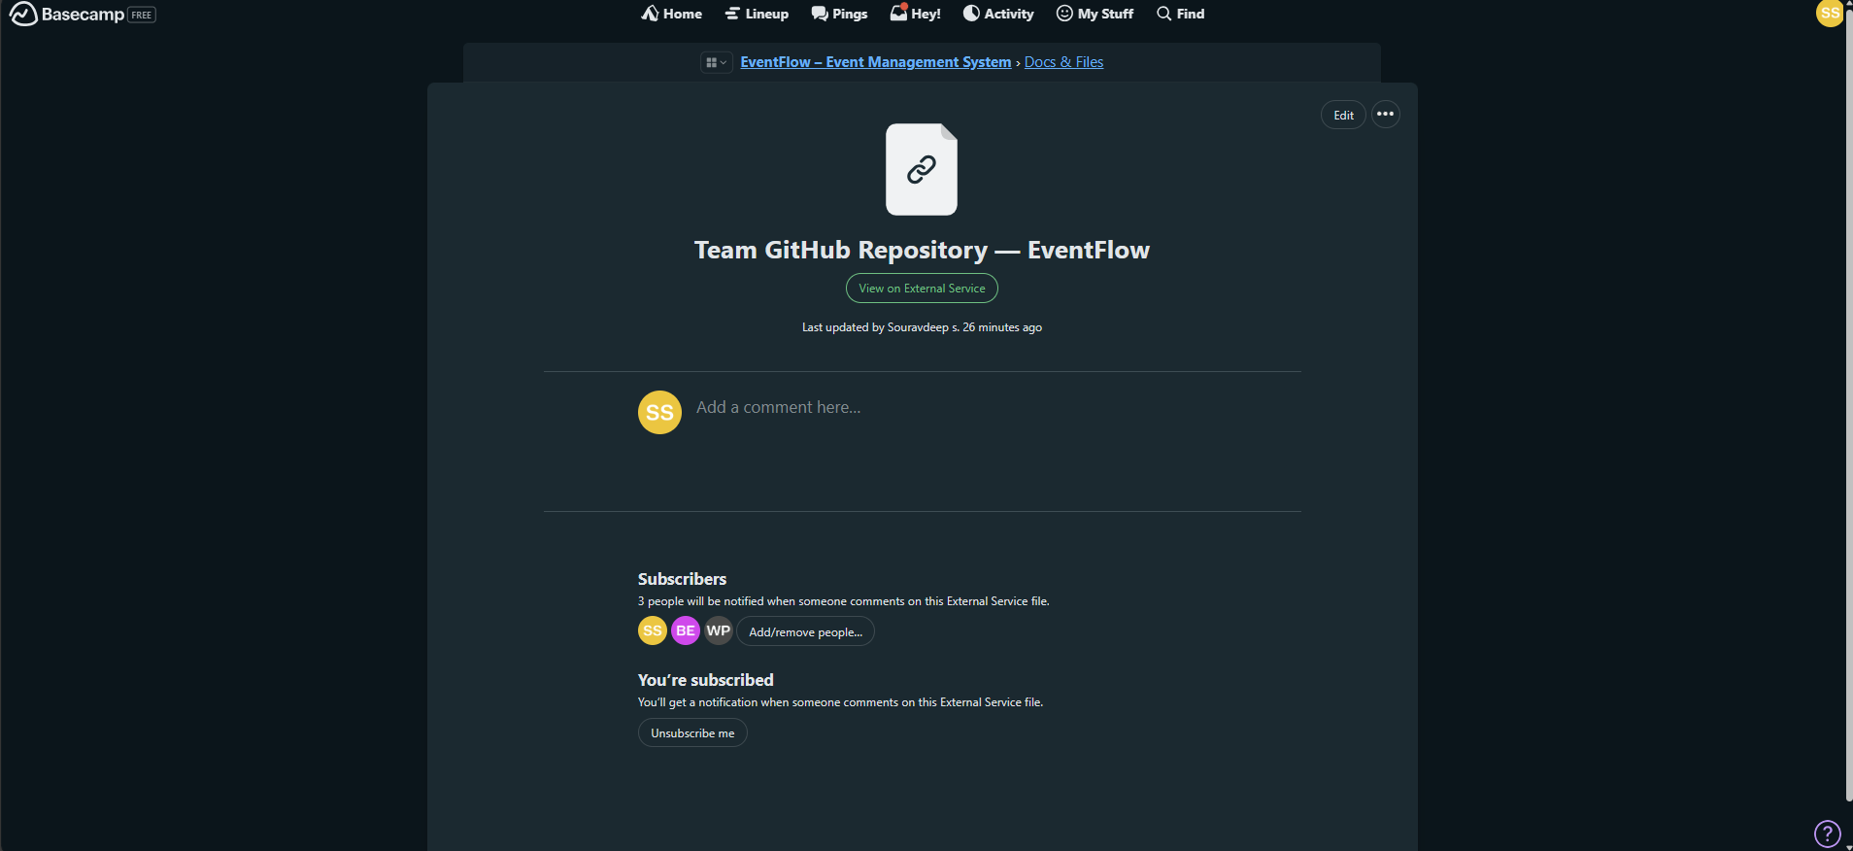










GitHub Repository & Resources
EventFlow Source Code
Basecamp Screenshot
Here is the attached Screenshot of the github repository link in Doc & File Section of Basecamp and also the link of all the scrennshot of the basecamp
Access the complete source code for the EventFlow Event Management System.
Repository
https://github.com/Souravv2412/EventFlowTeam_EventFlow
Commit History
https://github.com/Souravv2412/EventFlowTeam_EventFlow/commits/main/
https://github.com/Souravv2412/EventFlowTeam_EventFlow/blob/main/screen-shots/BaseCamp%20Screenshots.pdf
You can either download the complete project files from our public GitHub repository or view the source directly online
What You'll Find
Complete project source code
Development documentation
Clone Repository
View Source
Commit history tracking progress

Slide 9
















Conclusion & Next Steps
Conclusion
Next Steps
Integrated Solution
AI-Driven Analytics
EventFlow provides a comprehensive platform for end-to-end event management
Personalized attendee experiences and optimization
Expanded Integrations
Streamlined Process
Connecting with more third-party applications
From registration to post-event analysis, EventFlow eliminates inefficiencies
Global Scalability
Enhanced Experience
Optimization for international expansion
Improves engagement for both organizers and attendees
Join us in revolutionizing event management with EventFlow

